Slide 1
CIVX.US
When .gov's Do It Right.
Scrapers, widgets, and graphics for nysenate.gov, data.gov, and more.

Slide 2
Goals
To make the unavailable available
To make the available accessible
To make the accessible transparent

Slide 3
What is CIVX?
The Org
The Team
The Code

Slide 4
The Org
CIVX, Inc. is a 501c3 not for profit organization. As a public service we maintain http://CIVX.US -- a Free and Open platform built to aggregate raw data and provide tools for accessing and visualizing information.

Slide 5
The Founders
Luke Macken
    Senior Software Engineer, Red Hat, Inc.
    http://lewk.org
    @lmacken
Remy DeCausemaker
    Hacktivist & Storyteller, FOSS@RIT
    http://foss.rit.edu/blog/decause
    @remy_d

Slide 6
The Team
Rebecca Berent
    pixelninja@civx.us
Kate Dubuisson
    pythonprincess@civx.us
Nathaniel Case
    geopirate@civx.us
Stephen Jacobs
    Faculty Advisor, FOSS@RIT
Rebecca Berent
    pixelninja@civx.us
Kate Dubuisson
    pythonprincess@civx.us
Nathaniel Case
    geopirate@civx.us
Stephen Jacobs
    Faculty Advisor, FOSS@RIT

Slide 7
The Code
from civx import *

Slide 8
The Stack
Python
TurboGears2
Moksha

Slide 9
Python
  “Python is a programming language that lets you work more quickly and integrate your systems more effectively. You can learn to use Python and see almost immediate gains in productivity and lower maintenance costs.
  Python runs on Windows, Linux/Unix, Mac OS X, and has been ported to the Java and .NET virtual machines.
  Python is free to use, even for commercial products, because of its OSI-approved open source license.”
  Source: python.org

Slide 10
TurboGears
    Built on best-of-breed open source technology
    Top-to-bottom comprehensive web application stack
    Support for multiple data-exchange formats

Slide 11
Moksha
Modular
Plugin-driven
Highly-scalable
Real-time
Web platform

Slide 12
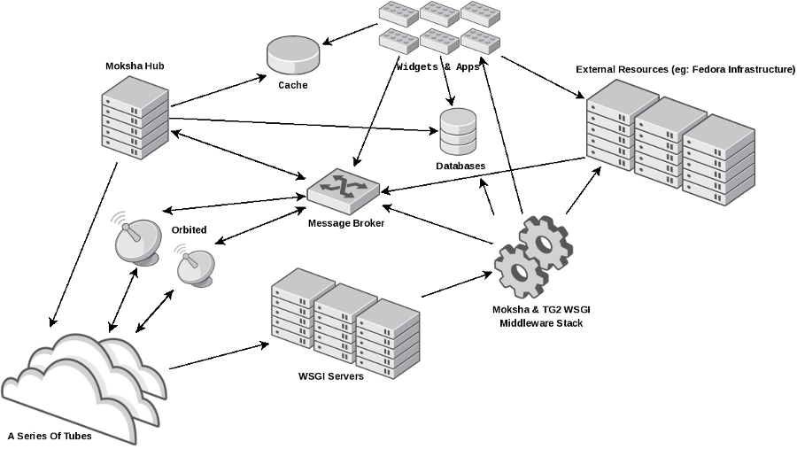

http://moksha.fedorahosted.org

Slide 13
CIVX Architecture
A platform for wielding data
    Scraper
    Widgets
    APIs

Slide 14
Problematic Scraping
Nathaniel Case

Slide 15
People Dashboard
Problems:
  Slow
  Scraped pages often have far more information than we want
  Hitting the Senate servers more often than necessary
Notes:
The people dashboard is cool and all, but it tends to be slow. When it has to hit the senate servers every time someone wants to look something up, it can take up to a few minutes to receive an answer. This is bad first for anyone trying to use CIVX, because who wants to use a system that slow, and second for the Senate's servers, who have to respond to any request we make, which particularly in the case of things like senator contact info aren't likely to change much.
Furthermore, there is a lot of information on the pages we scrape that we don't need, and sometimes it can look confusingly like information we do want, leading to a lot of code dealing with sifting through this information, taking up even more time.

Slide 16

People Dashboard: SoupStrainers
Senator pages generally follow a template, but it can be tricky
SoupStrainer removes all the unneccessary stuff
Notes:
The solution to the second problem turns out to be rather strightforward. You've already seen us using BeautifulSoup, and BeautifulSoup is beautiful. While I was neck-deep in BeautifulSoup API, I found out about SoupStrainers, something that made BeautifulSoup even better.
Most of the information we want on the pages wer scrape are helpfully contained in divs with class “field-content”. However, therte are a lot of divs with that class on a page. On this page in particular, there happens to be a div with an id of “content-area”, which happens to be the parent of all the “field-content”s we want.
What a SoupStrainer does for us is set the root of the tree to this div, rather than the root of the page and ignore everything else. That way we don't have to worry about getting the right divs and the code is simpler as well.

Slide 17

People Dashboard: Caching
Some senators have a lot of information
Lots of info → users waiting for senate servers
Want to be nice to senate servers
Reads all senate pages once, serves that info to users
Notes:
Now SoupStrainers help to a startling extent, but we still have to download the file every time we want to get at the information.
The solution to this problem turns out to be fairly easy as well. This function is a fairly standard pylons cache. 'cache' is a pylons module that has accessors for cache objects, and from the cache we get the value associated with the key 'senators'.
We have three arguments for the cache, the key, the backing function, and an expire period in seconds. If the key has no value or it has been expiretime seconds since it was last refreshed, we run our old get_nys_senators function, if not, we just use the cached information.
This speeds up individual senators' pages to seconds in the worst case, with the caveat that if the cache needs to be updated it will take a little over four minutes to refresh all the pages as we have to reload all senators at once.

Slide 18
“Difficult Data”
OpenSecrets.org
  We already had a scraper, but it was old and broken
  Enter the polyscraper
  Difficulty: passing login credentials
Notes:
This is not the only problematic dataset we had though, and there are a few hard ones out there. We had an OpenSecrets.org scraper from long ago, but it was unmaintained and updates to the OpenSecrets website rendered it broken. Wanting not only to get it running again and update it to the latest hotness, the task was to port the functionality to the polyscraper.
The only problem, and the reason this had not been done earlier was that OpenSecrets requires the user to log in to access their data, and in order to scrape this data automatically, we needed some way of logging in autonomously.

Slide 19
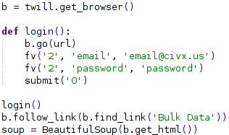
How?
Twill handles credentials
Use twill to browse, pass results to BeautifulSoup as normal.
Notes:
Twill, is, essentially, a headless browser with limited capabilities. It can, however put data in forms and keep credentials. Here is the OpenSecrets

Slide 20
More “Difficult Data”
SunlightNY.com – data hidden behind JavaScript
Ideal: twill-like module which can parse JavaScript
Realistic: headless browser with JavaScript interpreter
Backup: automate a full browser (Firefox) to handle the JavaScript
Notes:
This was the hardest problem we had to tackle so far. SunlightNY has a lot of data we'd like to get at, but the data is generated on the fly and the only way to get at it is a JavaScript request, something which is rather hard to do.
The only feasible way to run JavaScript outside of a browser is through Rhino, a pure Java Javascript engine. This, unfortunately, did not work well with our Python workflow, so I looked around for something similar in Python-land.
While projects like python-spidermonkey and pydermonkey do exist to leverage Mozilla's spidermonkey engine in Python, they have generally been abandoned as problems which are too hard for a few developers to pull off.

Slide 21
How?
Python → “magic” → Ruby → Watir → Firefox → Javascript
Notes:
Eventually Watir was brought up as a possible solution, which provided the third option, namely driving a real browser. This was far from ideal, as CIVX is run headless and it would not be fun to require a GUI just to satisfy one scraper.
Furthermore, the module itself ran in Ruby, which while better than Java, would still require some technical jiggery-pokery to make it work. Still ,there was a hint that a headless version could be possible, so I decided to see where this rabbit hole led.

Slide 22
How?
Python → “magic” → (J)Ruby → Celerity → Java → HtmlUnit → Rhino → JavaScript
  Too long... way too many layers
Notes:
Eventually, Celerity was discovered. Celerity is a headless browser which is API-compatible with Watir. What I did not immediately realize at the time was that it is now running in JRuby, and ends up using Rhino anyway internally.
This... mostly worked. Trying to diagnose Java errors from inside Ruby was not something I was expecting, and so eventually I had to take a look at what exactly I was doing here.
Finally I decided that while that 'magic' was in place I might as well strip out everything that wasn't essential to the process.

Slide 23
How?
Python → “magic” → Java → HtmlUnit → Rhino → JavaScript
  Better, but still need to worry about this magic
Notes:
I liked what I had seen of HtmlUnit as a browser using Rhino. HtmlUnit is a unit testing framework for automated testing of websites. After a lot of fiddling around, I managed to get the Java to get the pages I wanted, or most of the pages I wanted anyway, and now the 'magic' had to be tackled.

Slide 24
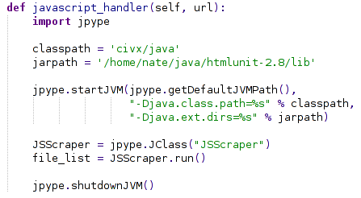
How?
Python → JPype → Java → HtmlUnit → Rhino → JavaScript
Notes:
After descovering the problem was mostly solved and deciding a solution could probably be found, the scraper was shelved for a bit to work on other projects. On a completely separate thread, I discovered JPype, the necessary parts of which are shown here in their entirety. JPype

Slide 25

Person and Location Widgets
Kate Dubuisson

Slide 26
Overview
Live demo
TurboGears
ToscaWidgets/CIVX
jQuery components
Using the OpenLegislation API
Scraping with BeautifulSoup
Location dashboard

Slide 27
Person Dashboard
Live Demo

Slide 28
TurboGears
Python-based web framework
Model/View/Controller structure
Person dashboard composed of:
  people.py (controller)
  senators.html/assemblers.html (view)
  profile.html (view)
  dashboard.mak (view)
  people_widget.py (model)

Slide 29
ToscaWidgets/CIVX
A framework for building web components
Used for person & location dashboards
    Built on top of ToscaWidget's widget object
Pulls together CSS, javascript, HTML template
Scraped data is passed to widget file

Slide 30
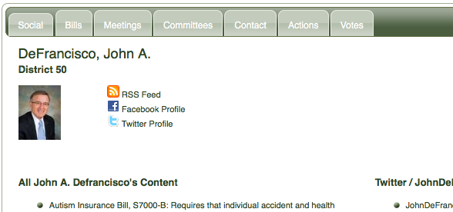
jQuery Components
Tabs used as container for both widgets
  jQuery UI package
  Pulled in through ToscaWidgets tw.jquery
Customizable through theme roller

Slide 31
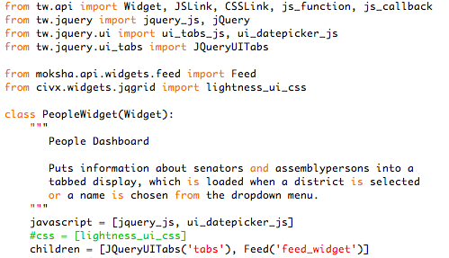
jQuery Components - Tabs
Added as “children” of the main widget
Other jQuery included directly in HTML

Slide 32
Using the OpenLegislation API
Bills, meetings, votes, and actions
    Returned as JSON objects
    civx.utils contains get_json method to decode
Each presented in an individual tab
Example:
http://open.nysenate.gov/legislation/search/?term=otype:meeting AND committee:transportation&format=json
name of committee
json, xml, or rss
meeting or vote

Slide 33
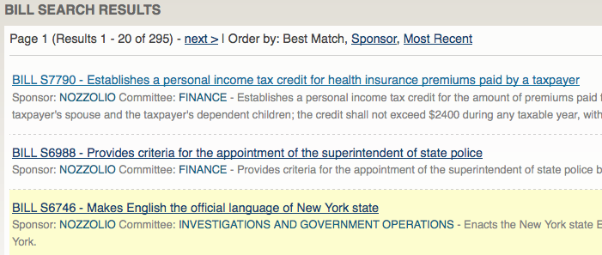
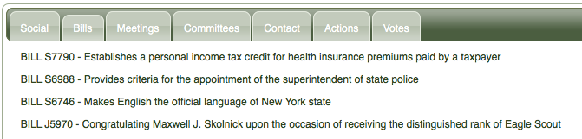
Example: Bills from nysenate.gov
c

Slide 34

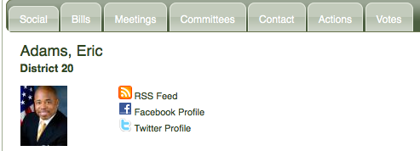
Scraping with BeautifulSoup
A Python HTML parser
Contact info, committee membership
Solution: scrape pages with BeautifulSoup
Also used to get headshots for senators
http://www.nysenate.gov/senators
“Widgetized”

Slide 35
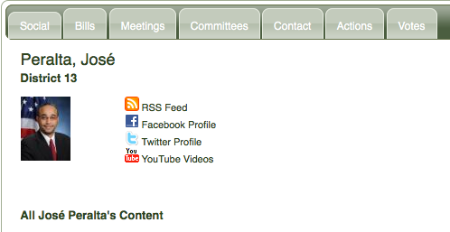
Scraping with BeautifulSoup
Challenges:
  Names – some had special characters
  Bad HTML formatting
  URL inconsistency – main page vs. contact

Slide 36

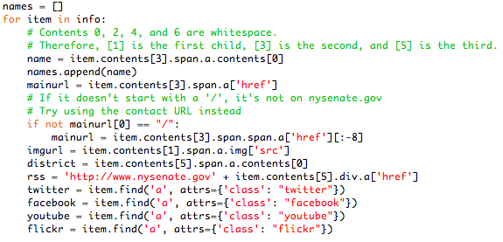
Example: scraping social links
Get only the HTML sections we're interested in:
Extract the relevant links from those sections:

Slide 37
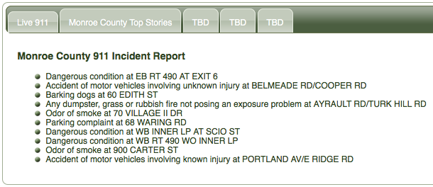
Location Dashboard
Same tabbed interface
Will contain widgets for state, district, or county-level datasets
Currently includes Live 911 widget

Slide 38
Design at CIVX
Rebecca Berent
Web, Graphic, and Multimedia Designer
(CIVX's Pixel Ninja)

Slide 39
Overview
MY ROLE AT CIVX
As CIVX's “Pixel Ninja”, I use data scraped
by the team to create visualizations that
convey information in organized, interesting,
beautiful, and often interactive ways.
I also work on the internal design of CIVX
including branding, poster and graphic
design and web design.

Slide 40
jQuery Widgets
GOAL
Create various jQuery widgets that display
the information CIVX scrapes look BEAUTIFUL!
IMPLEMENTATION
- jQuery/JavaScript
- HTML and CSS
- Adobe Photoshop and Illustrator

Slide 41
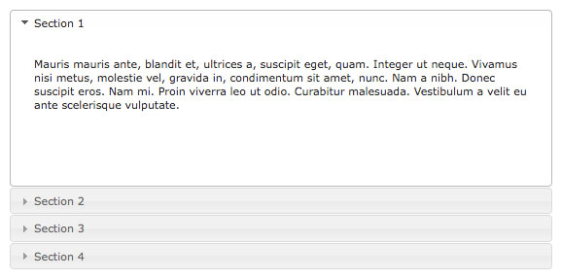
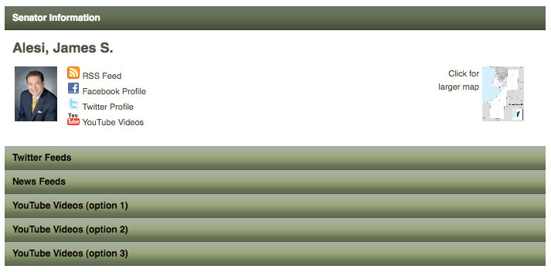
jQuery Widget Examples
VERTICAL ACCORDIAN
Using an available
jQuery widget from
docs.jquery.com,
I applied styles
and graphical
elements to make
the widget POP!
Example 1

Slide 42
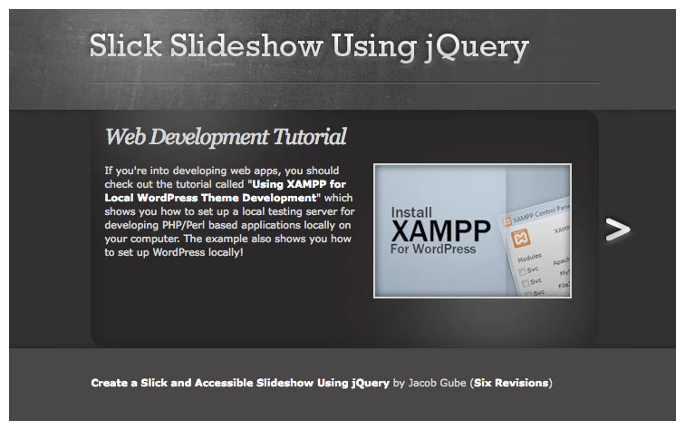
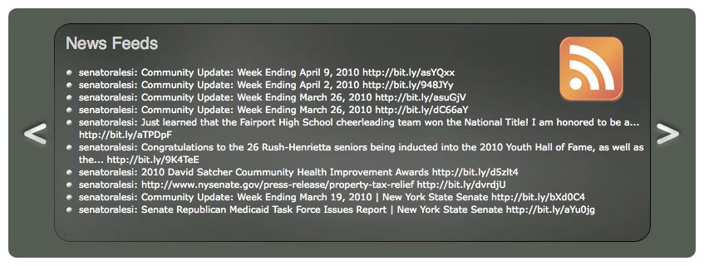
jQuery Widget Examples
VERTICAL ACCORDIAN 2
In order to provide several
mockups, I used another
available jQuery widget
from sixrevisions.com,
I made slight style
tweaks and added
relevant content
in order to see the
widget in action!
Example 2

Slide 43
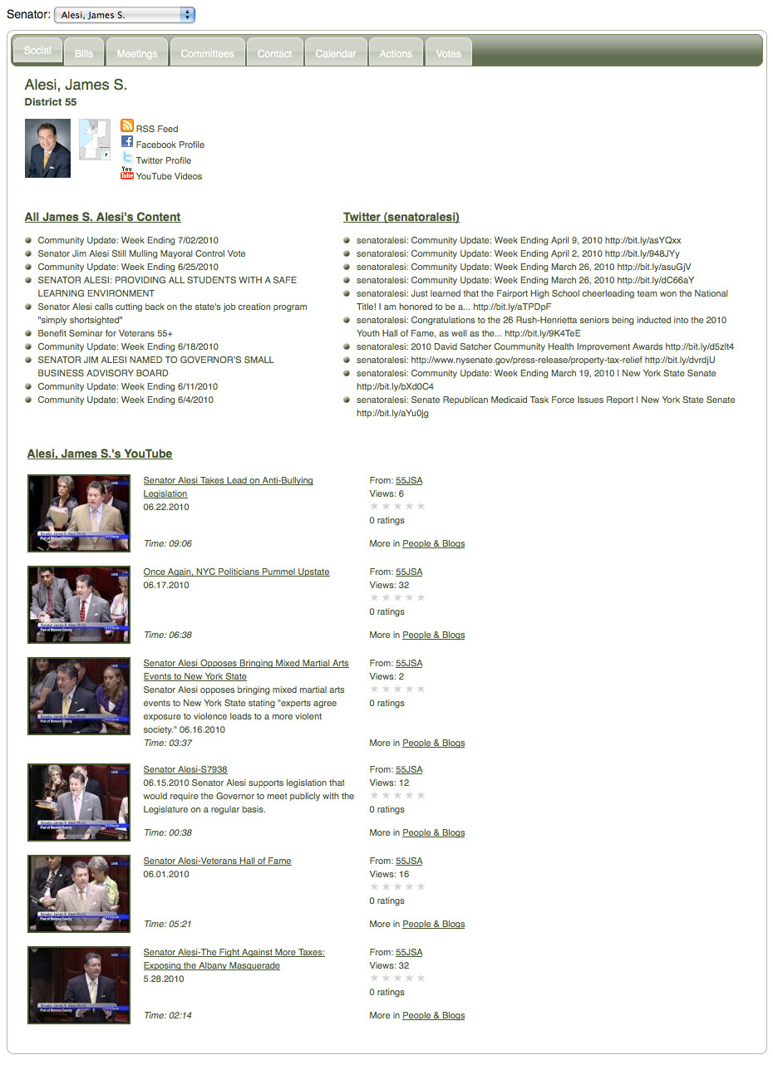
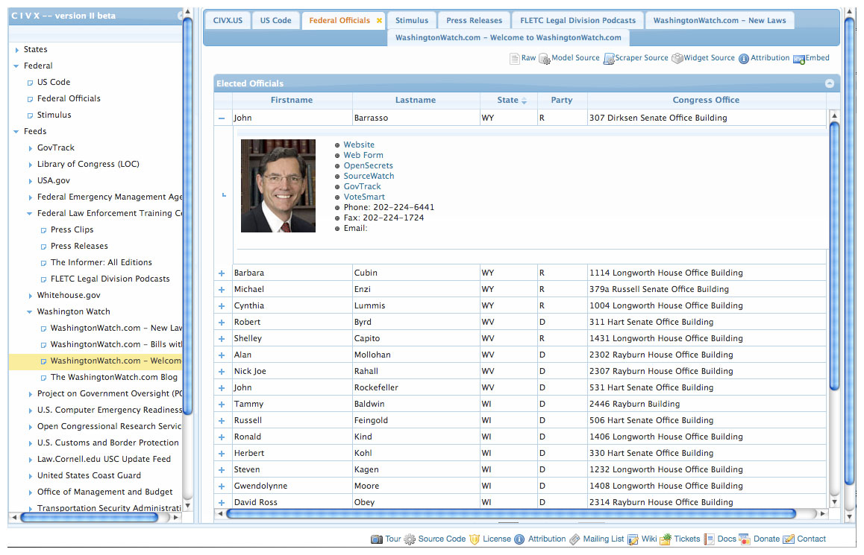
Re-Branding CIVX
BEFORE AND AFTER
These screenshots shows CIVX before
and after style and branding changes.

Slide 44
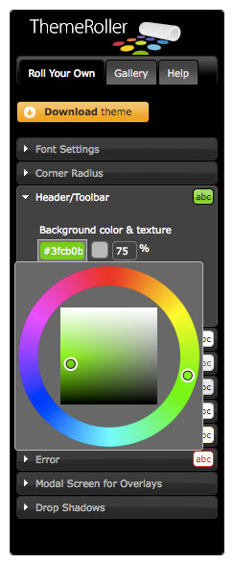

Re-Branding CIVX
JQUERY THEME ROLLER
n Available online (link)
n Allows for customization of any
site or widget that uses jQuery
in its infrastructure
n Begin by choosing colors and
type styles for your project
n CSS documents (as well as
JavaScript and other docs) are
generated by the Theme Roller

Slide 45
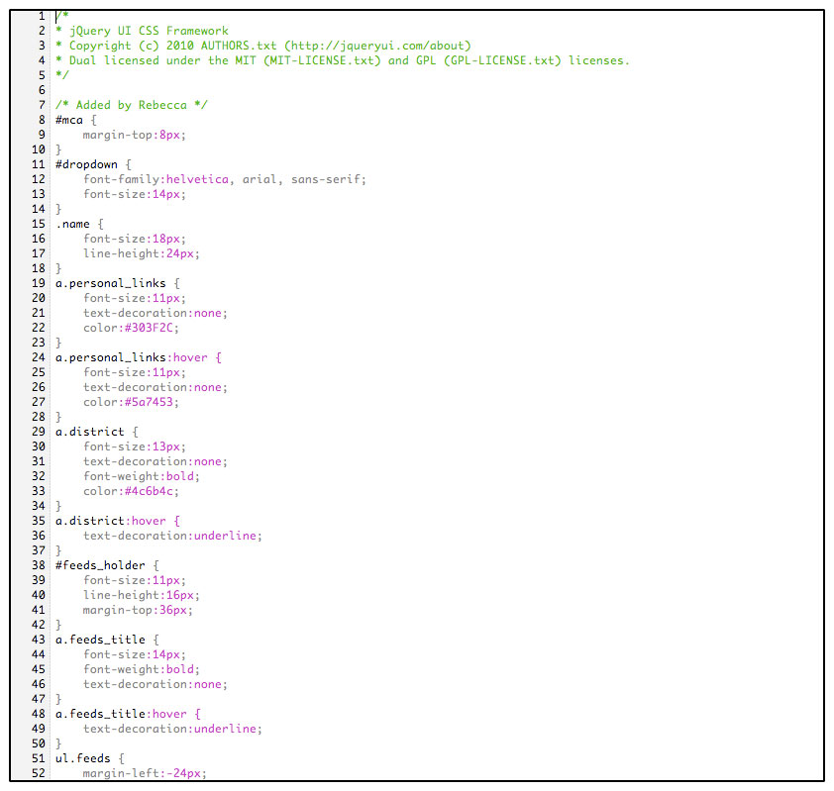
Re-Branding CIVX
CODING
n Making subtle changes to the
CSS may be necessary to achieve
ideal results
n Additions to the code could
include customized buttons,
bullets, or other elements,
Imagery, or sections you may
choose to style

Slide 46

Re-Branding CIVX
CHANGES TO LOGO
n Mockups and original concepts
include graphical concepts that
we believe best represent CIVX's
mission and visual output of data:
n Pixels
n Columns
n Flames
n Transparency
n Other imagery

Slide 47

Re-Branding CIVX
FINAL LOGO

Slide 48
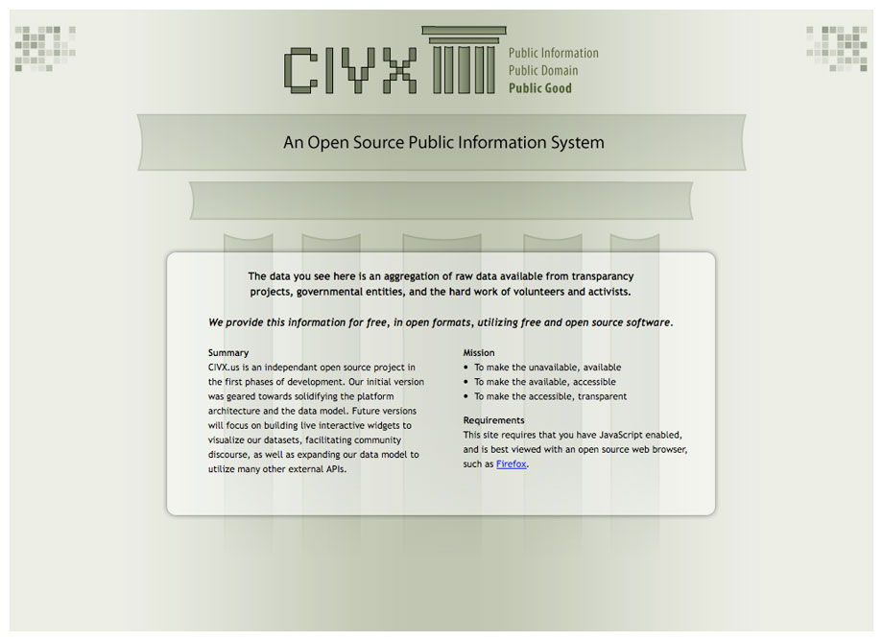






Re-Branding CIVX
MOCKUPS AND DESIGNS
n Banner designs and page layouts that
Include the new logo and pixel design

Slide 49
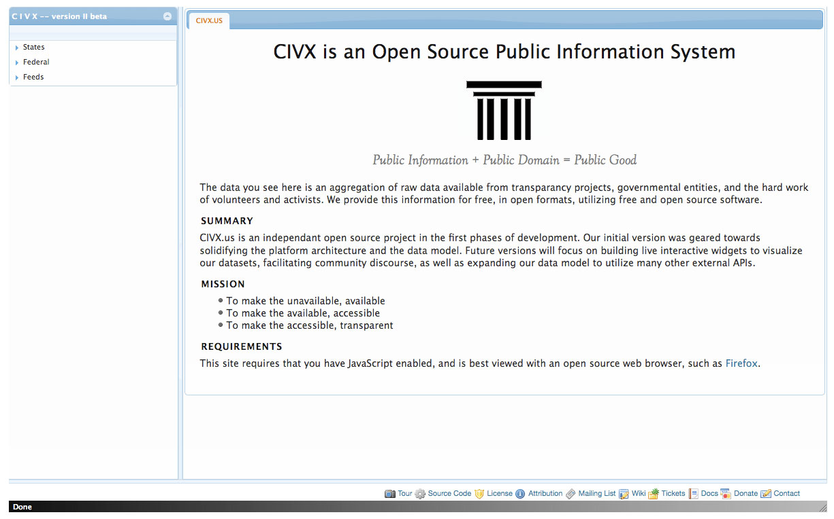
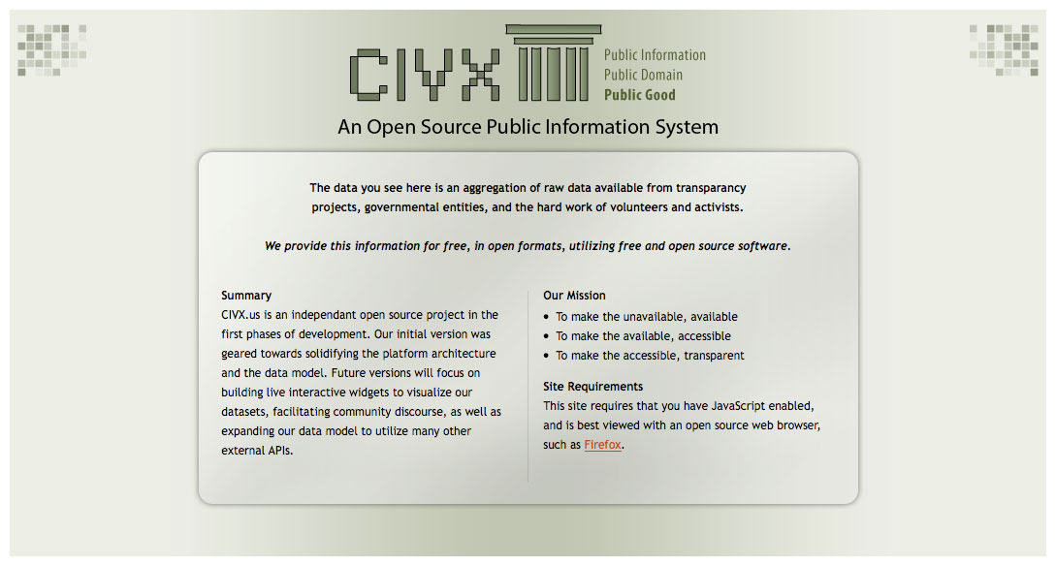
Re-Branding CIVX
CHANGES TO HOMEPAGE

Slide 50
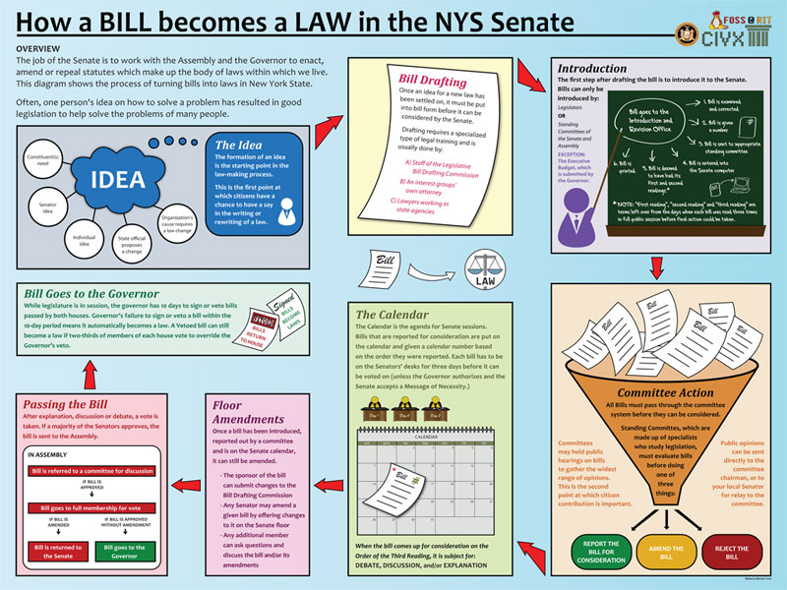
Information Visualizations
HOW A BILL BECOMES A LAW
n This infovis graphic shows the process, as outlined on the
NYS Senate website (link), of how a bill becomes a law

Slide 51
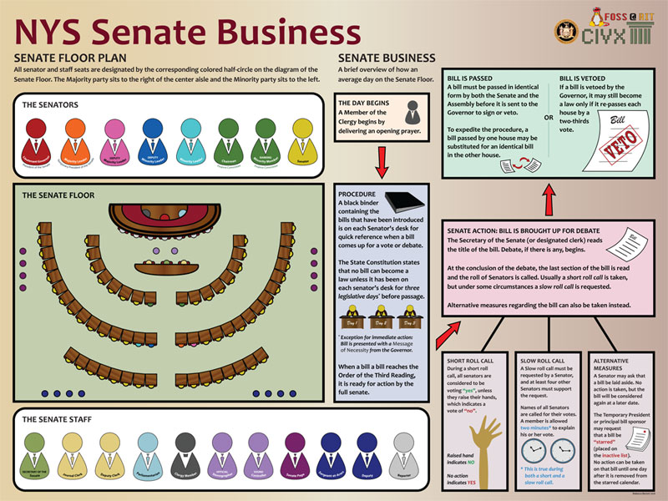
Information Visualizations
SENATE BUSINESS
n This infovis graphic shows the process, as outlined on the
NYS Senate website, of how a typical day runs on the Senate
floor. The graphic also shows how seating works.

Slide 52
Information Visualizations
IDEAS FOR THE FUTURE
n The previous visualization alone best communicates
information as a large-scale, printed poster.
n In the future, working with jQuery and other technologies,
this graphic will be edited and adapted for web.
n Tooltips and other animated transitions could be used to
make information not just beautiful, but fun and interesting
to interact with and learn.

Slide 53
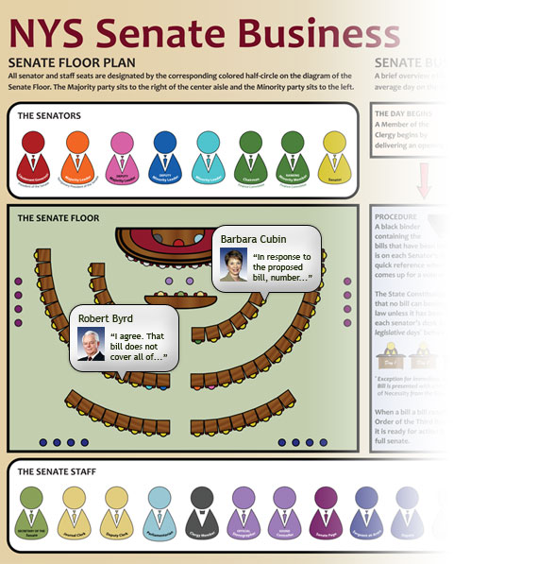
Information Visualizations
IDEAS FOR THE FUTURE
n A graphical layout
of the Senate Floor
online with “tool tips”
or “bubbles” that pop
up when a user rolls
over a Senate seat
with their mouse:
n Senator information
n Playbacks of the
Senate day with
speech bubbles
n and more!

Slide 54
Thank You!
QUESTIONS, COMMENTS, IDEAS?

